Slide 1
PERITONITIS
Presenter: Dr. orwa Ian
Supervisor: Dr Oketch, Dr. Aluora

Slide 2
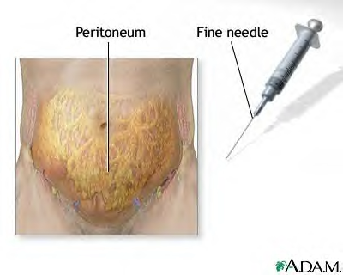

Slide 3
Peritonitis
Infection, or rarely some other type of
inflammation, of the peritoneum.
Peritoneum is a membrane that covers the
surface of both the organs that lie in the
abdominal cavity and the inner surface of
the abdominal cavity itself.

Slide 4
ETIOLOGY
As the complication of surgical pathology
Appendicitis – 50 %
Cholecystitis – 16 %
Perforation of gastric ulcer and cancer – 7 %
Pancreatitis – 6 %
Mesenteric thrombosis – 6 %
Colon cancer – 2 %
Postoperative peritonitis – 13 %
Primary peritonitis
Tuberculosis, canceromatosis, pneumonia, streptococcal infection, gonorrhea
Toxico-chemical aseptic peritonitis
Blood, urine, bile, pancreatic juice

Slide 5
CLASSIFICATION
According to the extension of inflammatory process:
Local – involvement of 1 anatomic area,
Diffuse – involvement of 3-6 anatomic area,
Generalized – involvement of all peritoneum.
According to the character of the exudate: serous, fibrinous, fibrino-purulent, purulent, hemorrhagic, septic.
According to the stages:
Reactive (first 24 hours) maximal manifestation of local signs of the disease;
Toxic (24-72 hours) – gradual reducing of local signs and increasing of general intoxication.
Terminal (after 72 hours) – severe, often unreversable intoxication with vital function decompensation.

Slide 6
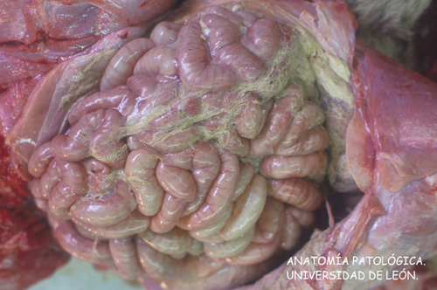
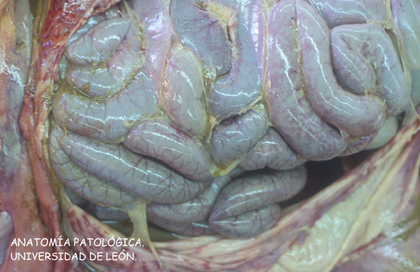

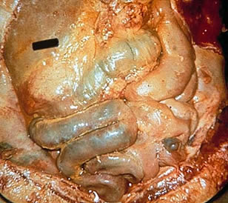
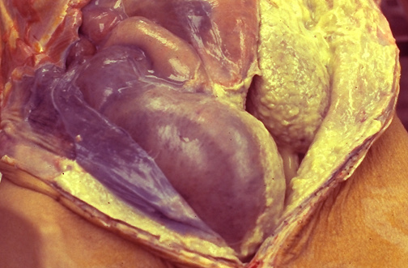

Slide 7
pathophysiology
Peritonitis is caused by leakage of contents from abdominal organs into the abdominal cavity, usually as a result of inflammation, infection, ischemia, trauma, or tumor perforation.
Edema of the tissues results, and exudation
of fluid develops in a short time.

Slide 8
pathophysiology
Fluid in the peritoneal cavity becomes turbid with increasing amounts of protein, white blood cells, cellular debris, and blood.
The immediate response of the intestinal tract is hypermotility, soon followed by paralytic ileus with an accumulation of air and fluid in the bowel.

Slide 9
PATHOGENESIS
Bacterial contamination
Reactive stage
Inflammatory reaction of the peritoneum
Exudation
Reabsorption of the microorganisms and toxins
Toxic stage
Hypovolemia, disturbances of water-electrolytic and protein balance
Intoxication
Toxic and hypovolemic shock
Paralytic ileus
Terminal stage
Disturbances of vital organ function, polyorganic insufficiency

Slide 10
2 Major Types
Primary: Caused by the spread of an infection from the blood & lymph nodes to the peritoneum. Very rare < 1%
Usually occurs in people who have an accumulation of fluid in their abdomens (ascites).
The fluid that accumulates creates a good environment for the growth of bacteria.

Slide 11
2nd Type:
Secondary: Caused by the entry of bacteria or enzymes into the peritoneum from the gastrointestinal or biliary tract.
This can be caused due to an ulcer eating its way through stomach wall or intestine when there is a rupture of the appendix or a ruptured diverticulum.
Also, it can occur due to an intestine to burst or injury to an internal organ which bleeds into the internal cavity.

Slide 12
Both cases are very serious & can be life threatening if not treated properly!!!

Slide 13
Symptoms depend on the location and extent of the inflammation.
The pain tends to become constant, localized, and more intense near the site of the inflammation. Movement usually aggravates it
The affected area of the abdomen becomes extremely tender and distended, and the muscles become rigid.

Slide 14
CLINICAL MANIFESTATIONS
Reactive stage
Sharp intensive pain.
Forced patient's position in bed.
Tachycardia 100-120 /min.
Dryness of tongue.
Abdominal tension over the site of inflammatory process or desk-like abdomen.
Peritoneal signs (Blumberg’s sign)
Decrease of peristalsis
X-ray examination could reveal pneumoperitoneum, intestinal pneumatisation, pleurisy
^

Slide 15
CLINICAL MANIFESTATIONS
Toxic stage
Decrease of pain.
Intensive vomiting.
Positive peritoneal signs (Blumberg’s sign)
Decrease of abdominal tension, abdominal distension.
Absence of peristalsis, paralytic ileus.
Tachycardia >120 /min.
Hypotonia.
Tachypnea.
Increase of body t° (> 38° C).
Dry tongue (like a brush).
Euphoria.

Slide 16
CLINICAL MANIFESTATIONS
Terminal stage
Disturbanses of CNS (adynamia, euphoria, psychomotoric excitement).
Facies Hyppocratica (prostration, face with drawn features, hollowed eyes).
Anuria.
Shallow breathing.
Fecal vomiting, absence of peristalsis, abdominal distension paralytic ileus.
Positive peritoneal signs
Thread-like pulse (impossible to count), hypotonia.
Cardiac arrhythmia, cardiac failure.
Disturbanses of blood coagulation.

Slide 17
Exam & Evaluation
Inspection: scars/asymmetry/distention
Palaption:
  Point of maximal tenderness
  Features of peritonitis (localised vs generalised)
      Guarding
      Percussion tenderness
      Rebound tenderness
  Mass
  Specific signs (Rovsing’s sign, murphy’s sign, cullen’s sign, grey-turner’s sign)
Percussion: shifting dullness/tympanic
Auscultation: bowel sounds
      Absent
      Normal
      Hyperactive
      tinkling
The above will point you to potential diagnosis

Slide 18
Evaluation con’t:
The usual sounds made by the active intestine and heard during examination with a stethoscope will be absent, because the intestine usually stops functioning.
The abdomen may be rigid and boardlike
Accumulations of fluid will be notable in primary due to ascites.

Slide 19
Exams con’t:
Simple Investigations:
    Bloods tests (FBC, U&E, LFT, amylase, clotting, CRP, G&S, ABG)
    Urine dipstick
    Pregnancy test (all women of child bearing age with lower abdominal pain)
    AXR/E-CXR
    ECG
More complex investigations:
    USS
    Contrast studies
    Endoscopy (OGD/colonoscopy/ERCP)
    CT
    MRI

Slide 20
The leukocyte count is elevated
The hemoglobin and hematocrit levels may be low if blood loss has occurred
Serum electrolyte studies may reveal altered levels of potassium, sodium, and chloride.

Slide 21
Treatment Approach
Hospitalization is common.
Surgery is often necessary to remove the source of infection.
Antibiotics are prescribed to control the infection & intravenous therapy (IV) is used to restore hydration.

Slide 22
Medical Management
Fluid,, and electrolyte replacement.
Hypovolemia occurs because massive amounts of fluid and electrolytes move from the intestinal lumen into the peritoneal cavity and deplete the fluid in the vascular space.
Analgesics, Antiemetics are prescribed
Intestinal intubation and suction assist in relieving abdominal distention and in promoting intestinal function.

Slide 23
Oxygen therapy by nasal cannula or mask can promote adequate oxygenation, but airway intubation and ventilatory
Massive antibiotic therapy is usually initiated early in the treatment of peritonitis.
Surgical objectives include removing the infected material and correcting the cause.

Slide 24
Prognosis
Untreated peritonitis is poor, usually resulting in death.
With Tx, prognosis is variable, dependent on the underlying causes.

Slide 25
Complications
The inflammation is not localized and the whole abdominal cavity becomes involved in a generalized sepsis.
Shock may result from septicemia or hypovolemia.
The inflammatory process may cause intestinal obstruction, primarily from the development of bowel adhesions.

Slide 26
complications
Postoperative complications are wound evisceration and abscess formation.
The sudden occurrence of serosanguineous wound drainage strongly suggests wound dehiscence.

Slide 27
Preventive Care
There is “NO WAY” to prevent peritonitis, since the diseases it accompanies are usually not under the voluntary control of an individual.
However, the best way to prevent serious complications is to seek medical attention as soon as symptoms appear.

Slide 28
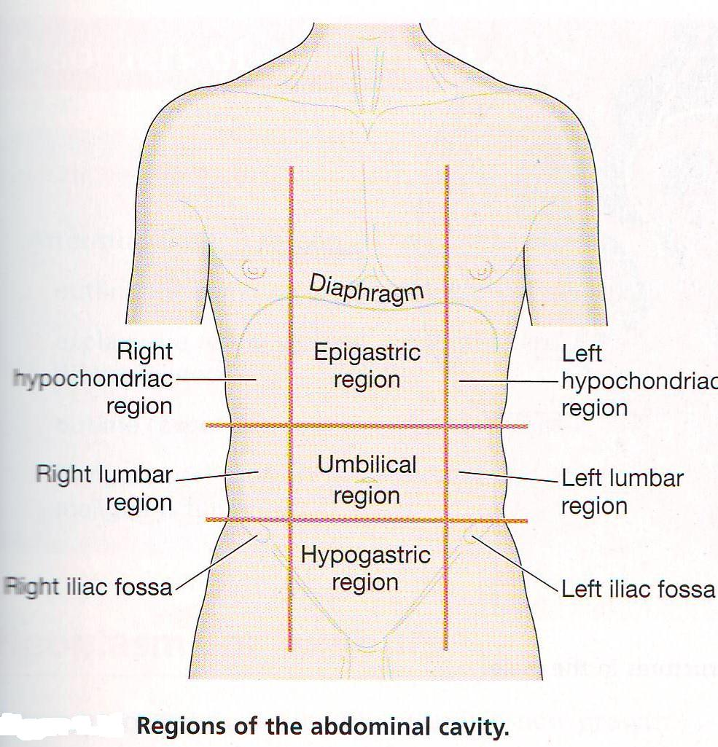
Acute Abdomen: differentials
Liver (hepatitis)
Gall bladder (gallstones)
Stomach (peptic ulcer, gastritis)
Transverse colon (cancer)
Pancreas (pancreatitis)
Heart (MI)
Liver (hepatitis)
Gall bladder (gallstones)
Stomach (peptic ulcer, gastritis)
Hepatic flexure colon (cancer)
Lung (pneumonia)
Spleen (rupture)
Pancreas (pancreatitis)
Stomach (peptic ulcer)
Splenic flexure colon (cancer)
Lung (pneumonia)
Ascending colon (cancer,)
Kidney (stone, hydronephrosis, UTI)
Descending colon (cancer)
Kidney (stone, hydronephrosis, UTI)
Appendix (Appendicitis)
Caecum (tumour, volvulus, closed loop obstruction)
Terminal ileum (crohns, mekels)
Ovaries/fallopian tube (ectopic, cyst, PID)
Ureter (renal colic)
Sigmoid colon (diverticulitis, colitis, cancer)
Ovaries/fallopian tube (ectopic, cyst, PID)
Ureter (renal colic)
Small bowel (obstruction/ischaemia)
Aorta (leaking AAA)
Uterus (fibroid, cancer)
Bladder (UTI, stone)
Sigmoid colon (diverticulitis)

Slide 29
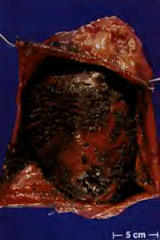
This occurs in acute pancreatitis

Slide 30
References:
“Evaluation and Management of Secondary Peritonitis.” American Family Physician 54 (October 1996): 1724+.
“Subacute Bacterial Peritonitis: Diagnosis and Treatment.” American Family Physician 52 (August 1995): 645.
Isselbacher, Kurt J., and Alan Epstein. “Diverticular, Vascular, and Other Disorders of the Intestinal and Peritoneum.” In Harrison’s Principles of Internal Medicine, ed. Anthony S. Fauci, et al. New York: McGraw-Hill, 1997.

Slide 31
References con’t:
Platell C., Papadimitiriou J M., Hall J.C. The Influence of Lavage Fluid on Peritonitis. Journal of American College Surg 2000; 191: 672-680.
Boeschoten, EW. Long-Term Consequences of Peritonitis. Perit Dial Int. 1996;16(suppl 1): S349-S354.

